Slide 1
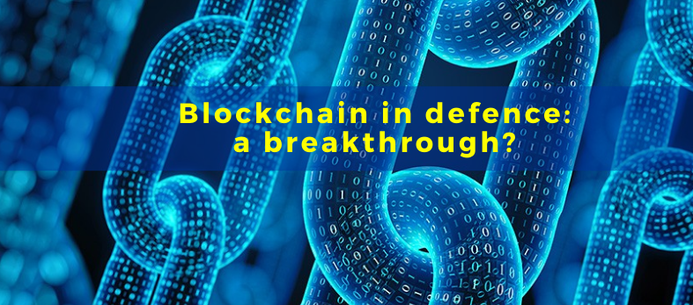
Pravasini Sahoo
Roll no-17

Slide 2
CONTENTS
What is blockchain?
Applications and functioning of blockchain technology in Defence
How Smart Contracts will help Defence
Developments in the blockchain technology in the military around the world
Conclusion
Pravasini Sahoo

Slide 3
What is Blockchain?
Pravasini Sahoo/Blockchain in Defence :a Breakthrough
21-Oct-20
Peer to Peer
Encrypted Information
3
A Digital Ledger
2
1
A blockchain is a digital ledger which keeps record of all transactions taking place on a peer to peer network
All information transmitted via blockchain is encrypted and every occurrence recorded, meaning once the block is created and added to chain, it cannot be alerted.
Lets you interact or send transactions with a peer, without a intermediary. Removes the middle man
Decentralization
Data Sharing
5
4
The blockchain is centralized so there is no need for central, certifying authority.
The blockchain can be used more than transfer of currency. It can also be used to share contracts, records and other type of data
2

Slide 4
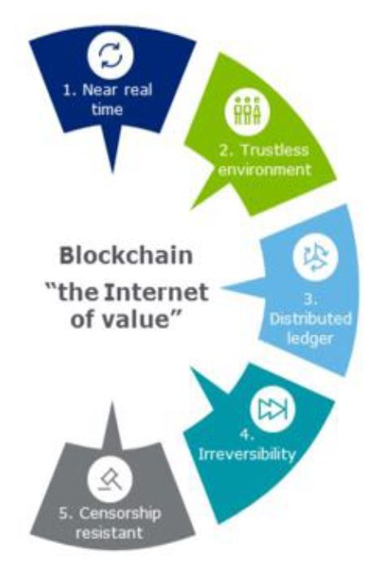
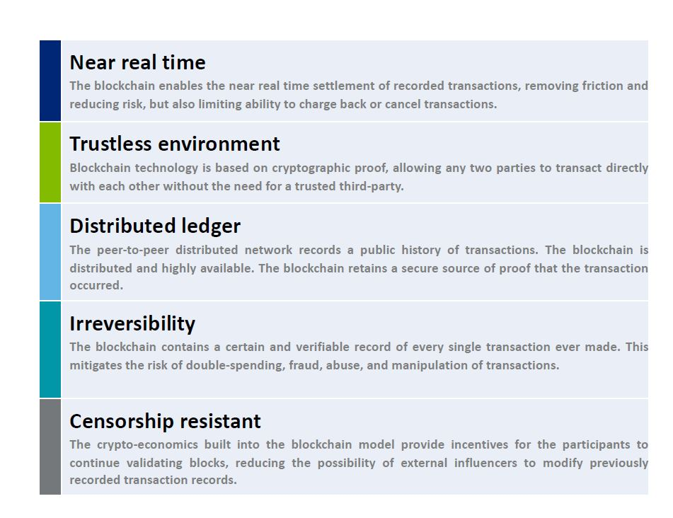
Pravasini Sahoo/Blockchain in Defence :a Breakthrough
21-Oct-20
3

Slide 5
Blockchain In Defence
Blockchain in Defence :a Breakthrough
21-Oct-20
Blockchain Technology in Defence, Blockchain for Military Defence, Blockchain for Aerospace and Defence are widely examined and explored today for several reasons. It is seen that the military and Defence sector are into implying the Blockchain Technology for maximizing their capacity in their different field of action.
Blockchain military use cases are many like the Military Drone Technology, Blockchain Battleships, Decentralized Weapon Control Systems
Apart from analyzing and storing real-time data, here the AI helps with self-governing automation of drone. The technology helps in flying the drones autonomously, with no intercession or control required from a human.
4

Slide 6
1.Blockchain in Military Uses of Defence
Blockchain in Defence :a Breakthrough
21-Oct-20
Applications and functioning of blockchain technology in Defence
Blockchain would be particularly useful in Defence. This technology has several advantages that stem from its decentralized nature.
Firstly, the distributed structure of the block chain ensures its availability. It also makes this technology less expensive.
Secondly, its resilience, security and immutability are particularly useful to store the data and are a strong asset for many military applications. That is the reason why aerospace and Defence industry trying to implement blockchain as one of the top emerging technologies they wanted to promote to increase industry growth and efficiency.
Technically, in the field of Defence, it seems that the private blockchain would be the most useful. With a public blockchain, access to the chain would not be controlled, which could be dangerous to protect sensitive information.
Since private blockchains are characterized by barriers to entry, with one administration in charge of accepting the participants and defining the rules of the chains (read and write permissions), they are the most suited to Defence uses. Access and system rules could be controlled by one entity: the Army Chief.
5

Slide 7
2.Blockchain in Cyber Defence and data integrity
Blockchain in Defence :a Breakthrough
21-Oct-20
In 2017, 235 GB of classified information belonging to South Korean and American intelligence services were stolen by North Korea. The same year, the European Commission stated that “there were more than 4,000 ransomware attacks per day and 80% of European companies experienced at least one cybersecurity incident.
Storing large amounts of highly sensitive information in the same place is particularly risky. In this context, the resilience offered by the blockchain, with its distributed nature and its ability to detect and block any penetrative attempt, can be significantly helpful.
As regards critical weapon systems, traditional weaponry is increasingly combined with the digitalization of the military. For instance, the US Navy is working on improving the ageing Aegis Combat System by using blockchain to secure more effectively the centralized com mand-and-control system that links the sensors with weapons within the system. This would enable the weapon to detect targets and fire in under a millisecond.
Blockchains are indeed secure and not alterable thanks to advanced cryptographic techniques.
Pravasini Sahoo
6

Slide 8
Blockchain in Defence :a Breakthrough
21-Oct-20
control of a critical weapons system –Traditional Method
Pravasini Sahoo
7

Slide 9
Blockchain-based control of a critical weapons system
Blockchain in Defence :a Breakthrough
21-Oct-20
Pravasini Sahoo
8

Slide 10
3.Blockchain in Supply chain management
Blockchain in Defence :a Breakthrough
21-Oct-20
One of the most important uses of the blockchain in supply chains is making them more transparent, secure and efficient.
Currently, the lack of such visibility leads to confusion and miscommunication among supply chain participants, as well as a lack of trust between them .By contrast, with blockchain, the private key used by a supply chain partner will enable this partner to be identified. Sensitive information like the type of goods, origin and destination could be encrypted and visible only to allowed participants.
On the battlefields, material traceability and visibility over the product’s path are essential. The Army also needs to be confident in pre-positioned materials and movements of capabilities to succeed in its operations. Blockchain technologies not only permit greater visibility on the material supply chain but can also improve food safety and healthcare on the battlefield.
Pravasini Sahoo
9

Slide 11
4.Blockchain In Resilient communication
Blockchain in Defence :a Breakthrough
21-Oct-20
Blockchain technology can provide resilient communications in a highly contested environment. In a high-end conflict , Defence departments should be prepared for the enemy to attack the electromagnetic spectrum and, particularly against critical communication systems such as satellites, undersea cables, and tactical datalinks.
Also, the enemy will try to manipulate data to break the kill chain. To face this threat, armies will need the capability to securely generate, protect and share data, which is possible thanks to chains of blockchain.
Pravasini Sahoo
10

Slide 12
How Smart Contracts will help Defence
Blockchain in Defence :a Breakthrough
21-Oct-20
Smart contracts are a set of computer programs on the blockchain that can automatically execute activities when certain conditions are met. They can be viewed as a normal contract with terms and conditions that is converted to a digital script and stored on the blockchain.
smart contracts can track the transfer of equipment from the vendor to buyer. Once the buyer receives the equipment as per the conditions given in the smart contract, it will automatically expedite the funds to seal the transaction.
Besides, smart contracts can eliminate the problems of delayed compliance or non-compliance to contractual issues and vendors’ propensity to contest penalties, a frequent problem in Indian defence contracts. Blockchain based smart contracts are legally fool-proof and hence, compliance is the only way out.
Pravasini Sahoo
11

Slide 13
DEVELOPMENTS IN THE BLOCKCHAIN TECHNOLOGY IN THE MILITARY AROUND THE WORLD
Blockchain in Defence :a Breakthrough
21-Oct-20
EU is building a European Blockchain Services Infrastructure which will deliver EU-wide cross-border public services using blockchain technology.
US Defence Advanced Research Projects Agency (DARPA) is working on weaponizing blockchain. The main area of concern for DARPA is data integrity systems, meaning ensuring that data are still in their original state, and seeing who has viewed these data.
The Russian Ministry of Defence also owns a newly established “Blockchain Research Laboratory”, named ERA. This research center explores how blockchain technology can be used to boost national security by detecting and preventing hacks on military infrastructure and enhance the military’s cyber-security.
China use blockchain to protect sensitive personnel and weapons data from cyber-attacks and make logistics operations safer and more efficient.
South Korea’s state Defence Acquisition Program Administration (DAPA) announced that it is working with multiple other agencies for an interoperable blockchain system.
NATO’s Communications and Information Agency called for blockchain applications regarding military logistics, procurement, and finance as well as “other applications of interest to the military”
Pravasini Sahoo
12

Slide 14
CONCLUSIONS
Blockchain in Defence :a Breakthrough
21-Oct-20
Blockchain technology has the potential to radically change our way of life, and the way we conduct military operations , both on an operational and support level.
Thanks to its decentralized and transparent nature, it could improve the decisions taken by military officials, while enhancing outcomes for military deployments.
The development of blockchain technology offers increased data confidence and data availability that can help shape future military logistics and planning.
Pravasini Sahoo
13

Slide 15


